Slide 1
Course Title: OOP 2 Course Code: CSC 2210
Dept. of Computer Science
Faculty of Science and Technology
Topis: C# Basics
Lecturer No: | 2.1 | Week No: | 2 | Semester: | Fall 2022-23
Lecturer: | Nyme Ahmed (nyme.ahmed@aiub.edu)

Slide 2
Identifiers
Identifiers are case sensitive.
Can not start with a number
Can not have white space (blank space)
Can not be a reserved keyword
Try using meaningful names. Underscore character is allowed.

Slide 3
Naming Conventions
There are 3 types of naming conventions.
Camel Case: firstName
Pascal Case: FirstName
Hungarian Notation: Not used in C#
For local variable: Must use Camel Case.
For constant variable: Use Pascal Case.

Slide 4
User Input/Output
User Input:
Console.Read(); // returns int (ASCII value)
Console.ReadLine(); // returns string
User Output:
Console.Write(); // no line break
Console.WriteLine(); //Line break after executing

Slide 5
Data Types
C# supports 2 kinds of data types.
Value type: Value types are so-called because they contain the actual value of the data they store.
For example, int a = 3
Reference type: Also known as objects. Reference types are created from class files. A reference type stores a reference to the location in memory of the object. If you are familiar with C/C++ then you can think of a reference to the memory location to be the same as a pointer. C# does not require you to use pointers.

Slide 6
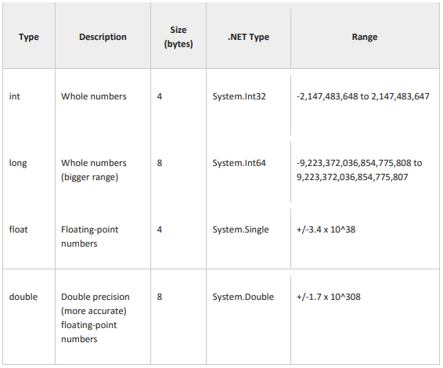
Data Types
Value types:
(Updated!)

Slide 7

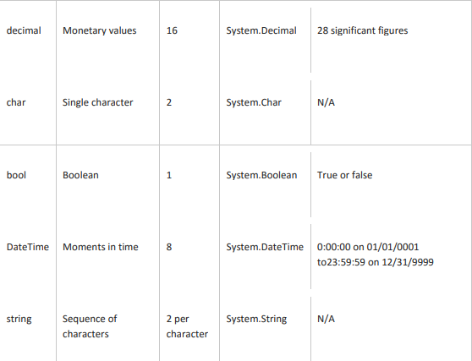
Data Types
Value types:
(Updated!)

Slide 8
Data Types
Reference types:
The reference data types do not contain the actual data stored in a variable, but they contain a reference to the variables.
If the data is changed by one of the variables, the other variable automatically reflects this change in value.
There are 2 types of reference data type in C#.
Predefined types: Such ad Object, String.
User defined types: Such as Classes, Interface.

Slide 9
Type Casting
Implicit Casting: Discussed in lecture 1
Explicit Casting: Discussed in lecture 1
C# also provides some other mechanisms to deal with casting type (from string to other data type).
Convert.TodataType() // Convert.ToInt32(Console.ReadLine());
dataType.Parse() // Int32.Parse(Console.ReadLine());
dataType.TryParse(string, out variableName)

Slide 10
Type Casting
Example of Convert.TodataType:
Console.Write("Enter first number:");
int num1 = Convert.ToInt32(Console.ReadLine());
Console.Write("Enter second number:");
int num2 = Convert.ToInt32(Console.ReadLine());
int sum = num1 + num2;
Console.WriteLine("The sum of {0} and {1}: {2}", num1, num2, sum);

Slide 11
Type Casting
Example of dataType.Parse() and dataType.TryParse():
int num1 = Int32.Parse(Console.ReadLine()); //4
Console.WriteLine(num1); //4
string a = Console.ReadLine(); //AIUB
Console.WriteLine(Int32.TryParse(a, out int b)); //False
string a = “AIUB”;
Console.WriteLine(Int32.Parse(a)); //Unhandled exception!!
string a = Console.ReadLine(); //4
Console.WriteLine(Int32.TryParse(a, out int b)); //True
Scenario 1
Scenario 2

Slide 12
Type Casting
Difference between Parse() and TryParse():
Parse() | TryParse()
Can not handle exception. | Can handle exception.
Only one parameter. | Two parameters are used.
Can not return Boolean value. | Return type: Boolean value (True or False)

Slide 13
Constants
A constant is an object whose value can’t be changed. They are used to prevent reassignment.
(Attempt to reassign a constant results in compiler error!)
Constants come in three flavors.
Literals
Symbolic Constants
Enumerations

Slide 14
Constants
Literals: 32 is a literal you can not change its value.
Symbolic Constants: Assign a name to a constant value. You declare a symbolic constant using the const keyword and the following syntax:
const type identifier = value;
You must initialize a constant when you declare it, and once initialized it, it can’t be altered. Example-
const int FreezePoint = 32;
Here, 32 is literal constant and FreezePoint is a symbolic constant of type int.

Slide 15
Constants
Enumerations:
It is a distinct value type, consisting of a set of named constants. Also known as enumerator list.
The enum keyword is used to declare an enumerations.
By default, the first enumeration has the value 0, and the value of each successive enumerator is increased by 1. For example, in the following enumeration, Sat is 0, Sun is 1, Mon is 2, and so on.
enum DayName {Sat, Sun, Mon, Tues, Wed, Thurs, Fri};

Slide 16
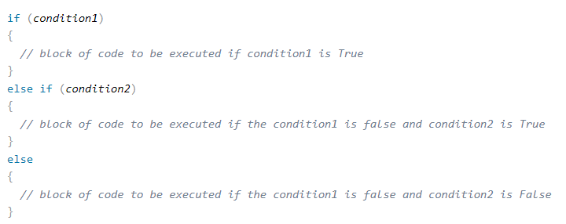
if, else, else if
Use the if statement to specify a block of C# code to be executed if a condition is True.
Use the else statement to specify a block of code to be executed if the condition is False.
Use the else if statement to specify a new condition if the first condition is False.
Syntax

Slide 17
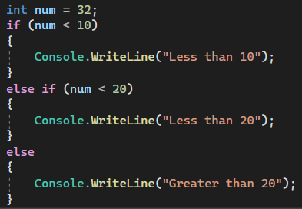
if, else, else if
What will be the output??

Slide 18
Switch
Switch is used to select one of many code blocks to be executed.
break keyword, it breaks out of the switch block.
The default keyword is optional and specifies some code to run if there is no case match.

Slide 19
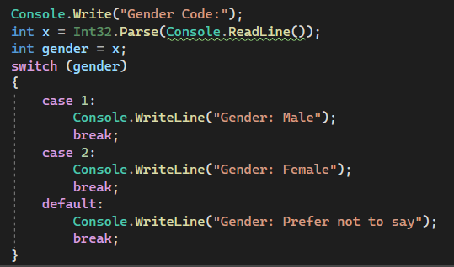
Switch
What will be the output??

Slide 20
Repetition
Visual C# provides a number of standard constructs known as loops that you can use to implement iteration logic.
for loop
The for loop executes a block of code repeatedly until the specified expression evaluates to false. You can define a for loop as follows.
for ([initializers]; [condition]; [iterator])
{
// code to repeat goes here
}

Slide 21
Repetition
while loop
The test condition is given in the beginning of the loop and all statements are executed till the given condition satisfies.
while (condition)
{
loop statements...
}

Slide 22
Repetition
do-while Loop
do while loop is similar to while loop with the only difference that it checks the condition after executing the statements.
do
{
statements..
}while (condition);

Slide 23
Repetition
for each Loop
There is also a foreach loop, which is used exclusively to loop through elements in an array.
foreach (type variableName in arrayName)
{
// code block to be executed
}

Slide 24
Break/Continue in Loops
The break statement can also be used to jump out of a loop.
The continue statement skips one iteration in the loop.
for (int i = 0; i < 5; i++)
{
if (i == 3)
{
break;
}
Console.Write(i +” “);
}
Output: 0 1 2
for (int i = 0; i < 5; i++)
{
if (i == 3)
{
continue;
}
Console.WriteLine(i);
}
Output: 0 1 2 4

Slide 25
Methods
A method is a block of code which only runs when it is called. Example-
class Program {
static void Main(string[] args) {
CallMethod();
}
static void CallMethod() {
Console.WriteLine("Method is called!");
}
}
Here, static means that the method belongs to the Program class and not an object of the Program class.

Slide 26
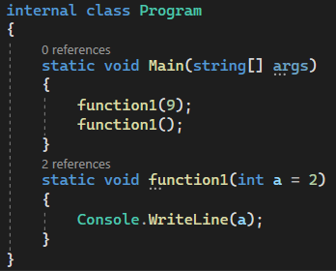
Methods
Default Parameter:
Created by using the equal (=) sign.
Call the method without an arguments means called the default value.

Slide 27
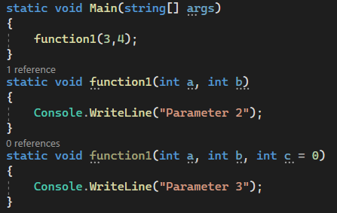
Methods
Multiple Parameter:

Slide 28
Methods
Named Parameter:
static void Main(string[] args)
{
function1(3,c:5);
}
static void function1(int a, int b = 0, int c = 1)
{
Console.WriteLine("{0} {1} {2}",a,b,c);
}

Slide 29
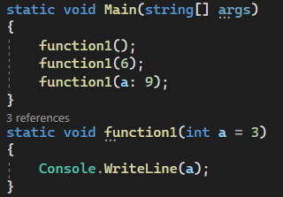
Methods
What will be the output??

Slide 30
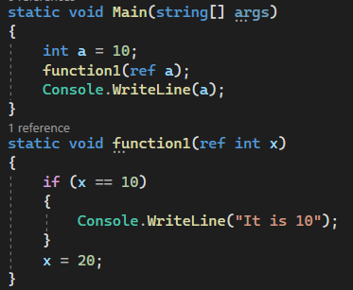
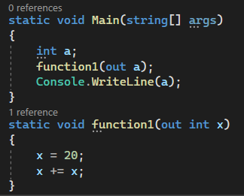
Use of Ref and Out Keywords
Ref: Out:

Slide 31
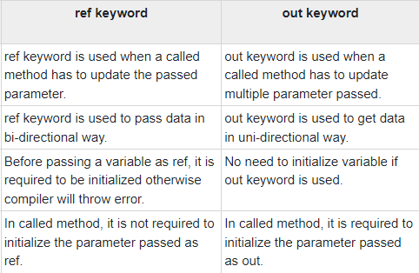
Use of Ref and Out Keywords
Differences between Ref and Out:

Slide 32
Struct
Used to hold small data values.
The struct keyword is used for creating a structure.
Structures can have defined constructors, but not destructors. However, you cannot define a default constructor for a structure. The default constructor is automatically defined and cannot be changed.
Structures cannot inherit other structures or classes.
Structures cannot be used as a base for other structures or classes.

Slide 33
Struct
static void Main(string[] args) {
Coordinate point;
point.x = 20;
point.y = 40;
Console.WriteLine(point.x); //output: 20
Console.WriteLine(point.y); //output: 40
}
struct Coordinate{
public int x;
public int y;
}

